Slide 1
Numerical methods for solving cutoff equation of coaxial cables
Wissam Razouki
CSE 3802

Slide 2
Brief intro/background

Slide 3
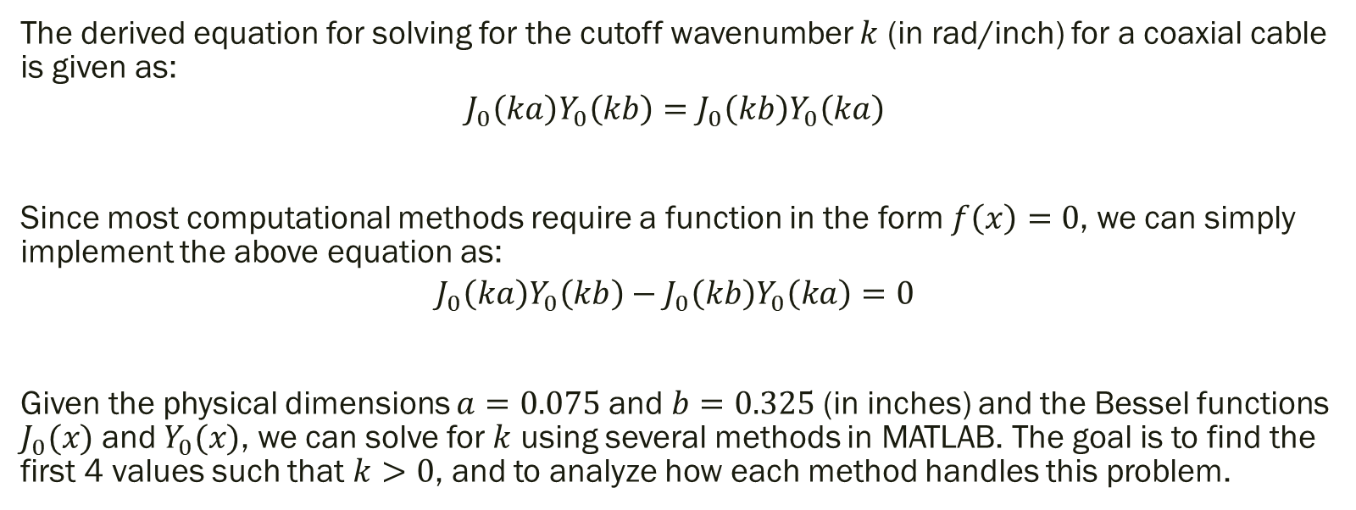
Cutoff Equation
The derived equation for solving for the cutoff wavenumber $k$ (in rad/inch) for a coaxial cable is given as:
$$J_{0}\left(ka\right)Y_{0}\left(kb\right)=J_{0}\left(kb\right)Y_{0}\left(ka\right)$$
Since most computational methods require a function in the form $f\left(x\right)=0$, we can simply implement the above equation as:
$$J_{0}\left(ka\right)Y_{0}\left(kb\right)−J_{0}\left(kb\right)Y_{0}\left(ka\right)=0$$
Given the physical dimensions $a=0.075$ and $b=0.325$ (in inches) and the Bessel functions $J_{0}(x)$ and $Y_{0}(x)$, we can solve for $k$ using several methods in MATLAB. The goal is to find the first 4 values such that $k>0$, and to analyze how each method handles this problem.

Slide 4
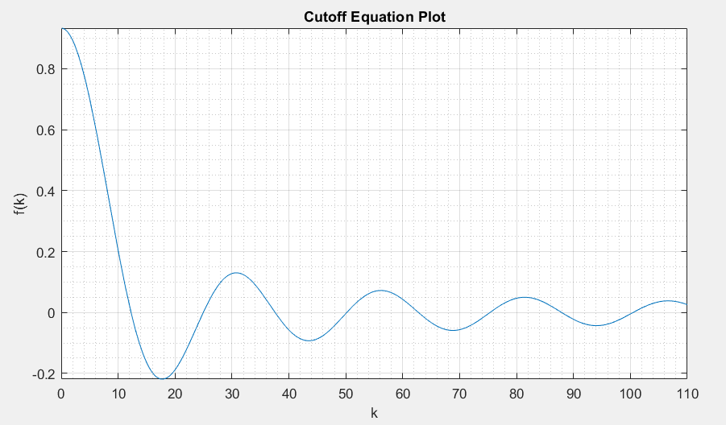
~12.26
~37.57
~62.75
~87.91
~24.95
~50.17
~75.33
~100.48
Plotting the function in MATLAB gives us a good idea of where the roots for $k$ lie.
This was used to verify the code for the various numerical methods.

Slide 5

Methods Used
Newton-Raphson
Secant
Steffensen’s secant
Bisection
Monte Carlo bisection
Regula falsi
Modified regula falsi ($f(b)/2$)

Slide 6
Testing

Slide 7
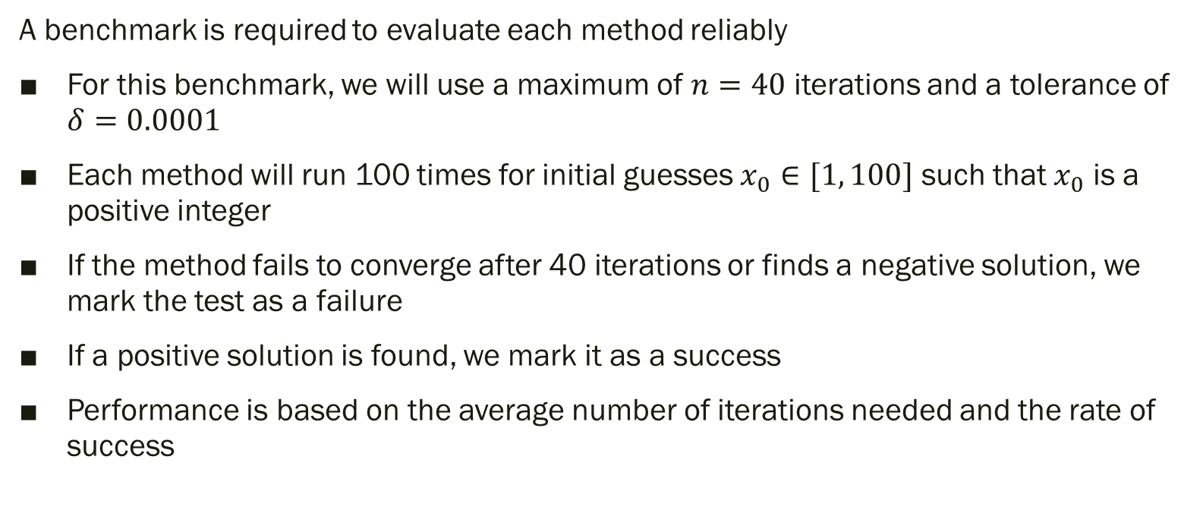
Benchmark – One Initial Guess
A benchmark is required to evaluate each method reliably
For this benchmark, we will use a maximum of $n=40$ iterations and a tolerance of $δ=0.0001$
Each method will run 100 times for initial guesses $x_{0}∈[1, 100]$ such that $x_{0}$ is a positive integer
If the method fails to converge after 40 iterations or finds a negative solution, we mark the test as a failure
If a positive solution is found, we mark it as a success
Performance is based on the average number of iterations needed and the rate of success

Slide 8
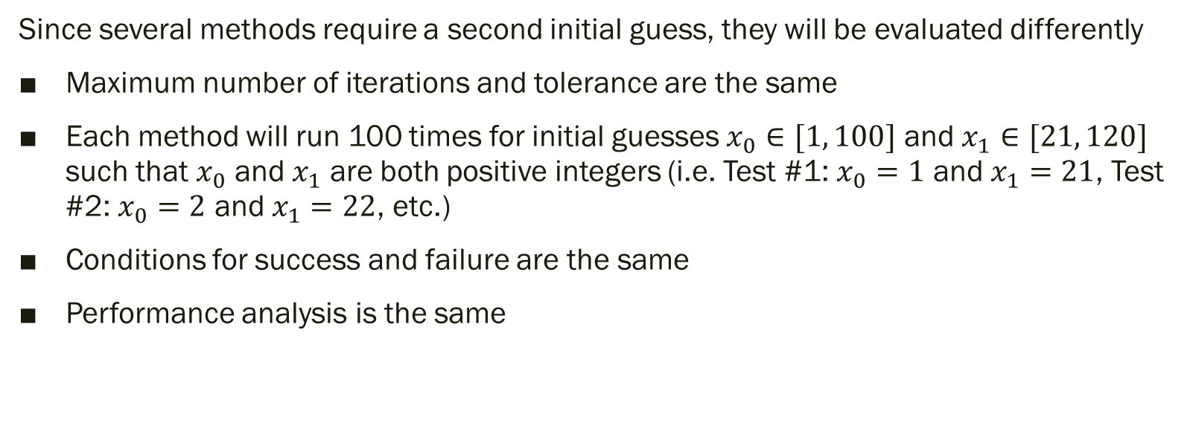
Benchmark – Two Initial Guesses
Since several methods require a second initial guess, they will be evaluated differently
Maximum number of iterations and tolerance are the same
Each method will run 100 times for initial guesses $x_{0}∈[1, 100]$ and $x_{1}∈[21, 120]$ such that $x_{0}$ and $x_{1}$ are both positive integers (i.e. Test #1: $x_{0}=1$ and $x_{1}=21$, Test #2: $x_{0}=2$ and $x_{1}=22$, etc.)
Conditions for success and failure are the same
Performance analysis is the same

Slide 9
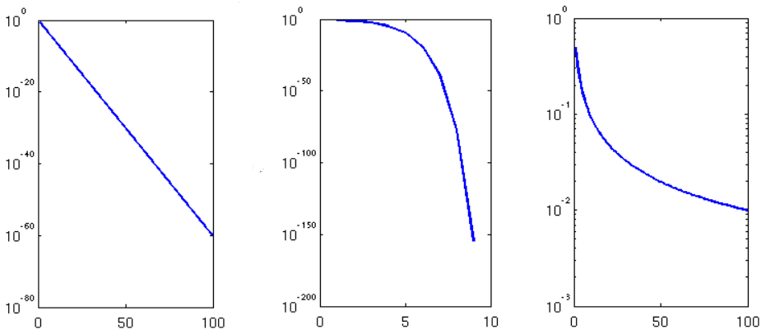
Rate of Convergence
A rate of convergence for each method can be estimated based on the step-to-step error of the output for a certain input.
Plotting this error vs. the iteration in logarithmic form, we can approximate one of three types of convergence: linear, quadratic, or logarithmic.
From Wikipedia

Slide 10
Results

Slide 12
Test Data
The data above shows how many iterations it took for each method to find a solution based on the (first) initial input.
Notable points:
Monte Carlo bisection and modified regula falsi are the only methods that reach the maximum number of iterations (and thus, fail to find a solution)
This is due to the unstable nature of these methods
Steffensen’s secant and Newton-Raphson seem to be the best performing methods

Slide 13
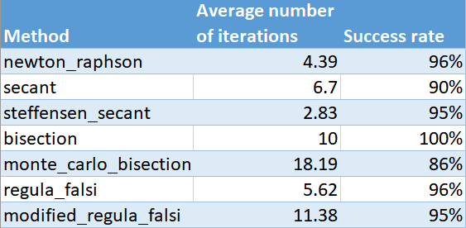
Performance Data

Slide 14
Performance Summary
The data above aggregates the number of iterations and the success rate for each method.
According to the data, we can conclude that:
Steffensen’s secant is the fastest method for finding roots in the least amount of iterations
Bisection is the most reliable method as it always converges to a solution
Monte Carlo bisection is the worst method both in terms of speed and reliability

Slide 15
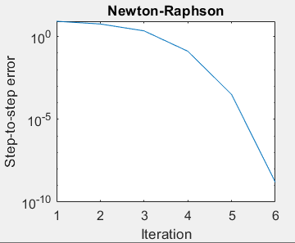
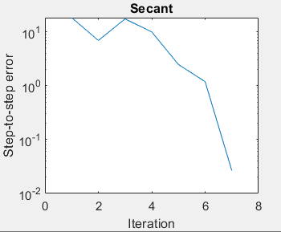
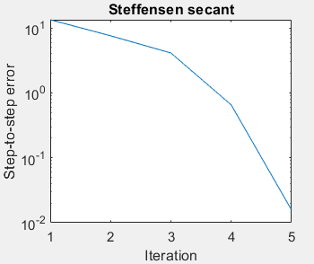
Estimated Rates of Convergence
Quadratic
Almost Quadratic
Quadratic

Slide 16
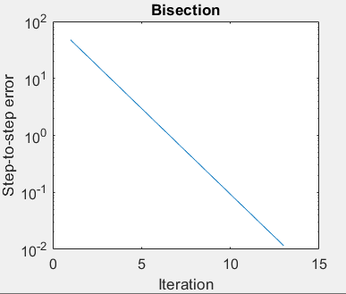
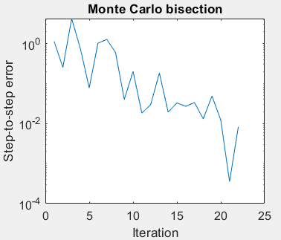
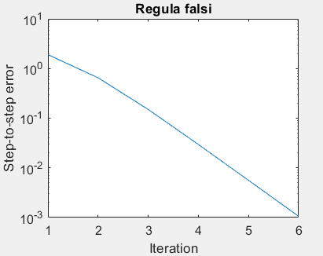
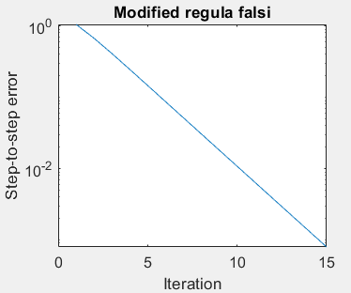
Linear
Random (pseudolinear)
Almost linear
Almost linear

Slide 17
Analysis and Conclusions
According to these results, we can conclude that:
Steffensen’s secant is the fastest algorithm
Bisection is the most reliable algorithm
These methods are best suited for this problem
Monte Carlo bisection and modified regula falsi are unstable, slow and unreliable
These methods are not suited for this problem

